Slide 1
Android Studio
Università di Modena e Reggio Emilia

Slide 2
Intro
Android Studio is the official Android IDE.
Is based on IntelliJ IDEA.
Includes:
Android SDK and JDK (Java Development Kit)
Gradle plugins
Android emulator
Android profiler
GitHub integration
Layout design tool
Debug tools
Testing tools and framework (JUnit)
Access to device’s filesystem
Android logging and output console
Android Project Wizard: simplifies creating new project

Slide 3
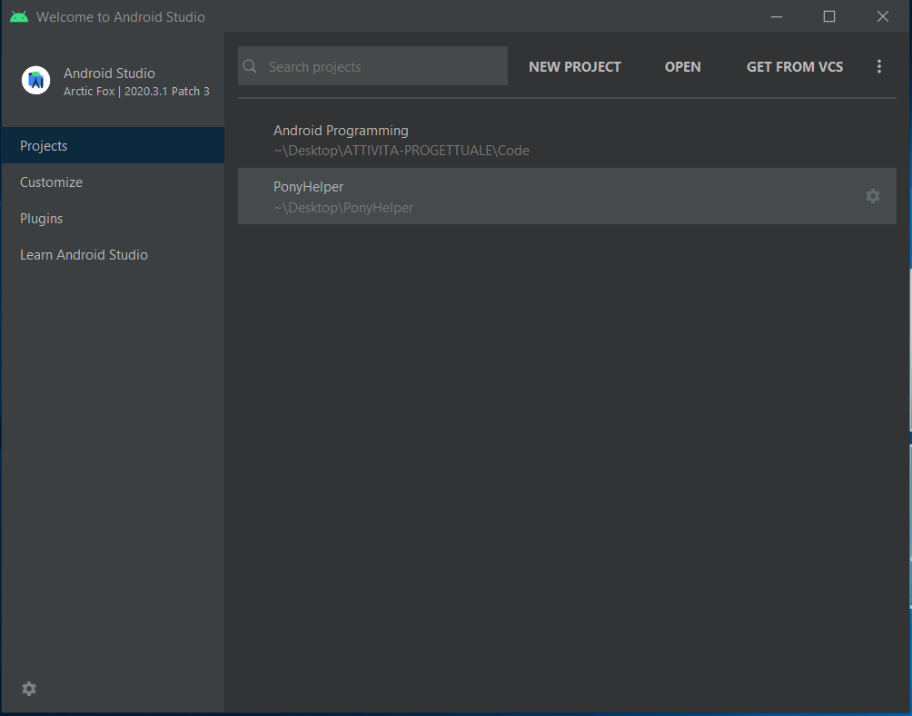
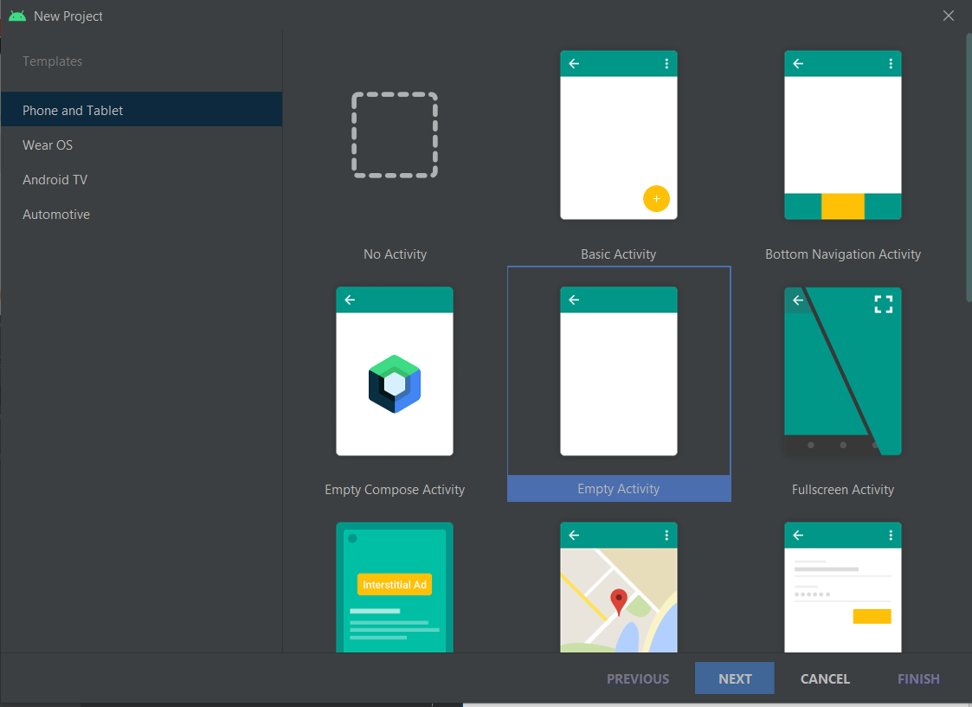

Project creation

Slide 4
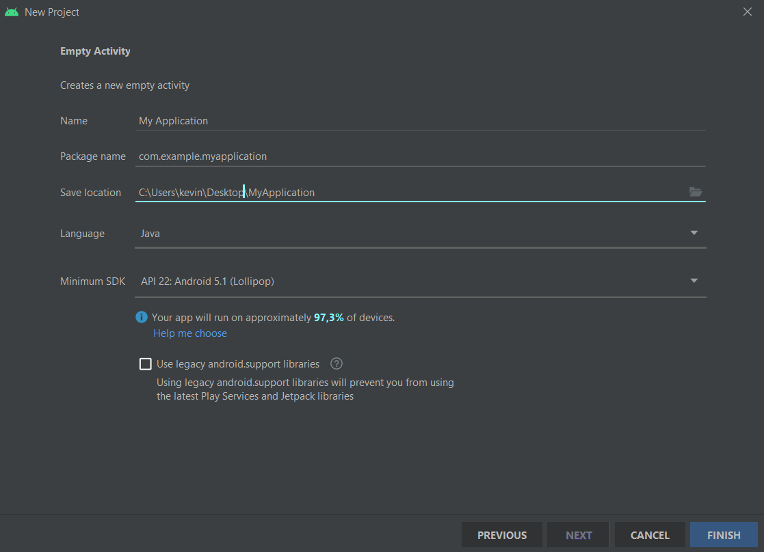
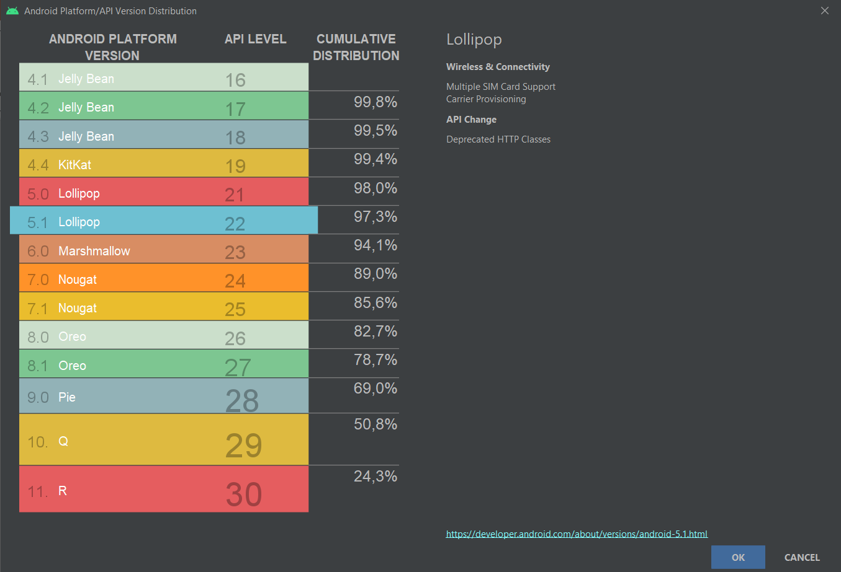
Project creation (2)
App name
Programming language
API / SDK version

Slide 5
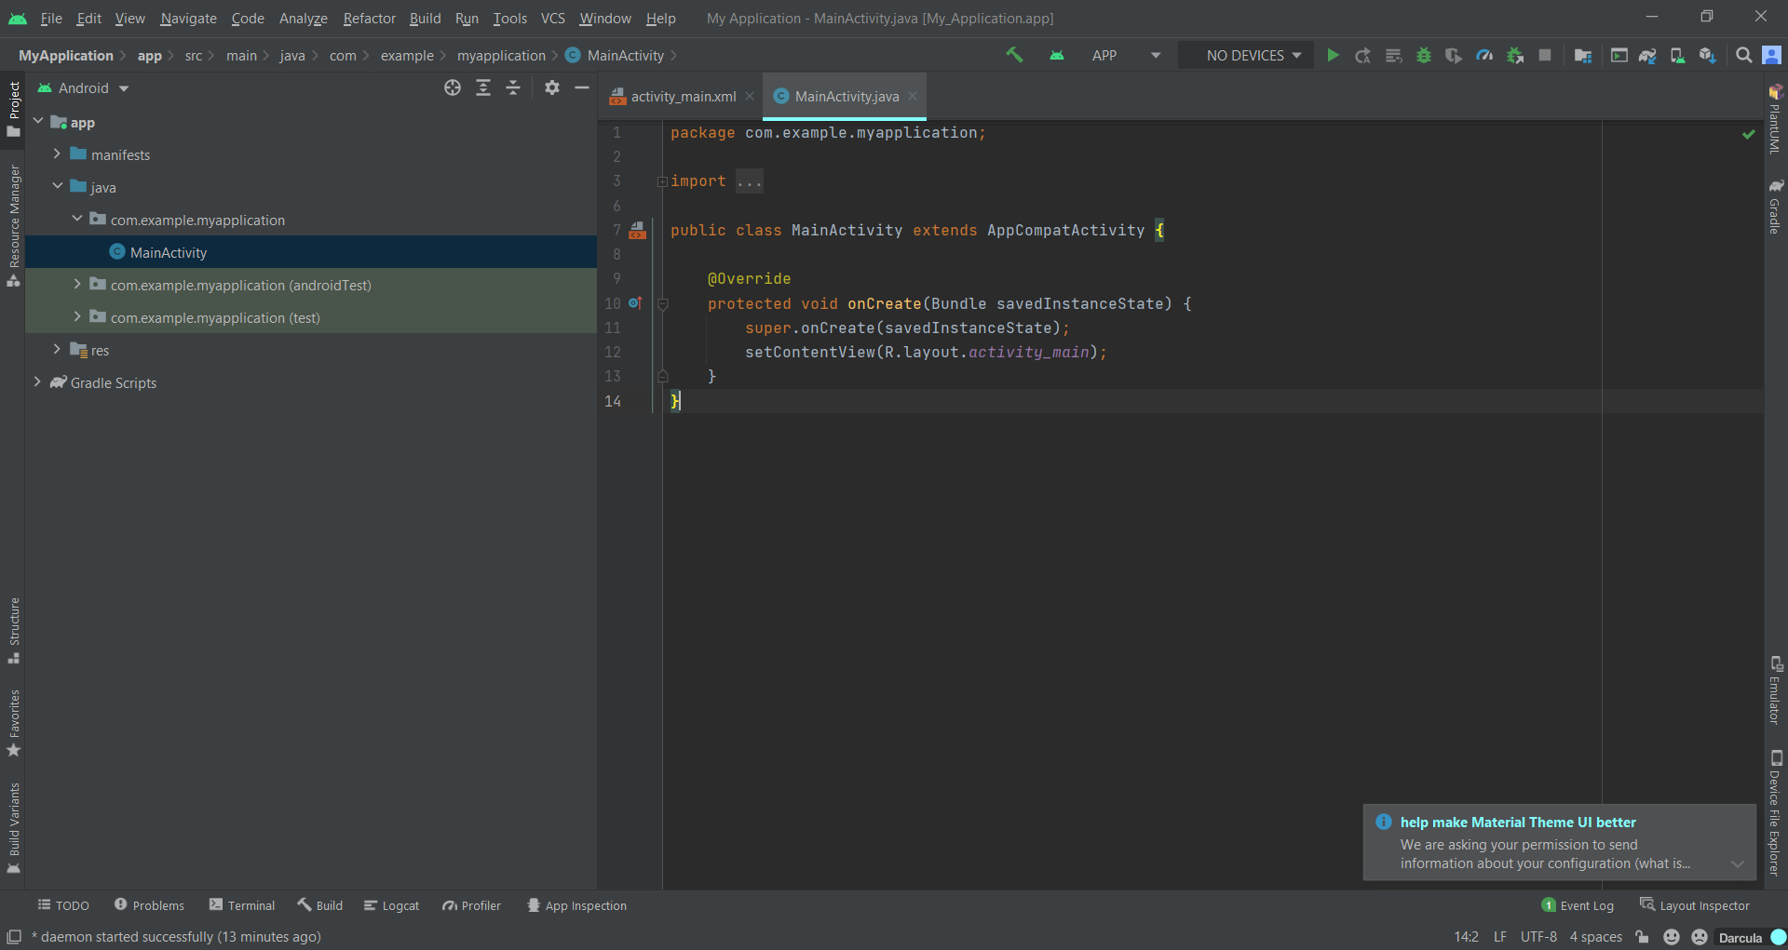
Android Studio Tools
1
2
Menu Bar
Toolbar
Navigation Bar
Editor Window
Status Bar
Project Tool Window
3
4
6
5

Slide 6
Toolbar
Profiler
Build project
Available devices
App debug
Stop app
Sync project
SDK Manager
Apply changes
Run/Debug configurations
Run/Install app on selected device
Project Structure
AVD Manager

Slide 7
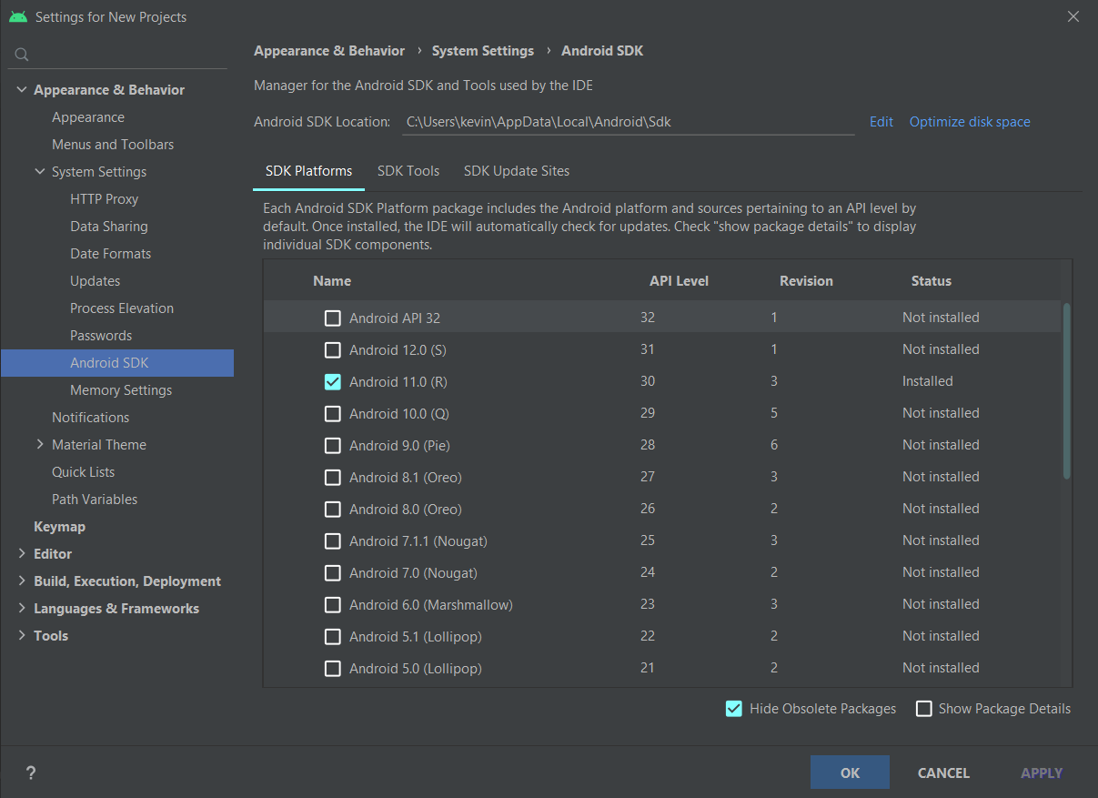
SDK Manager
Tools ➔ SDK manager
Manage Additional SDK Components.
SDK Platform: you can install SDK version and related API
SDK tools: you can see available update and new tools

Slide 8
AVD Manager
In Android Studio you can create a AVD (Android Virtual Device) an emulator where you can install and run your application.
AVD Manager is the tool that help you to create and manage your AVD.

Slide 9
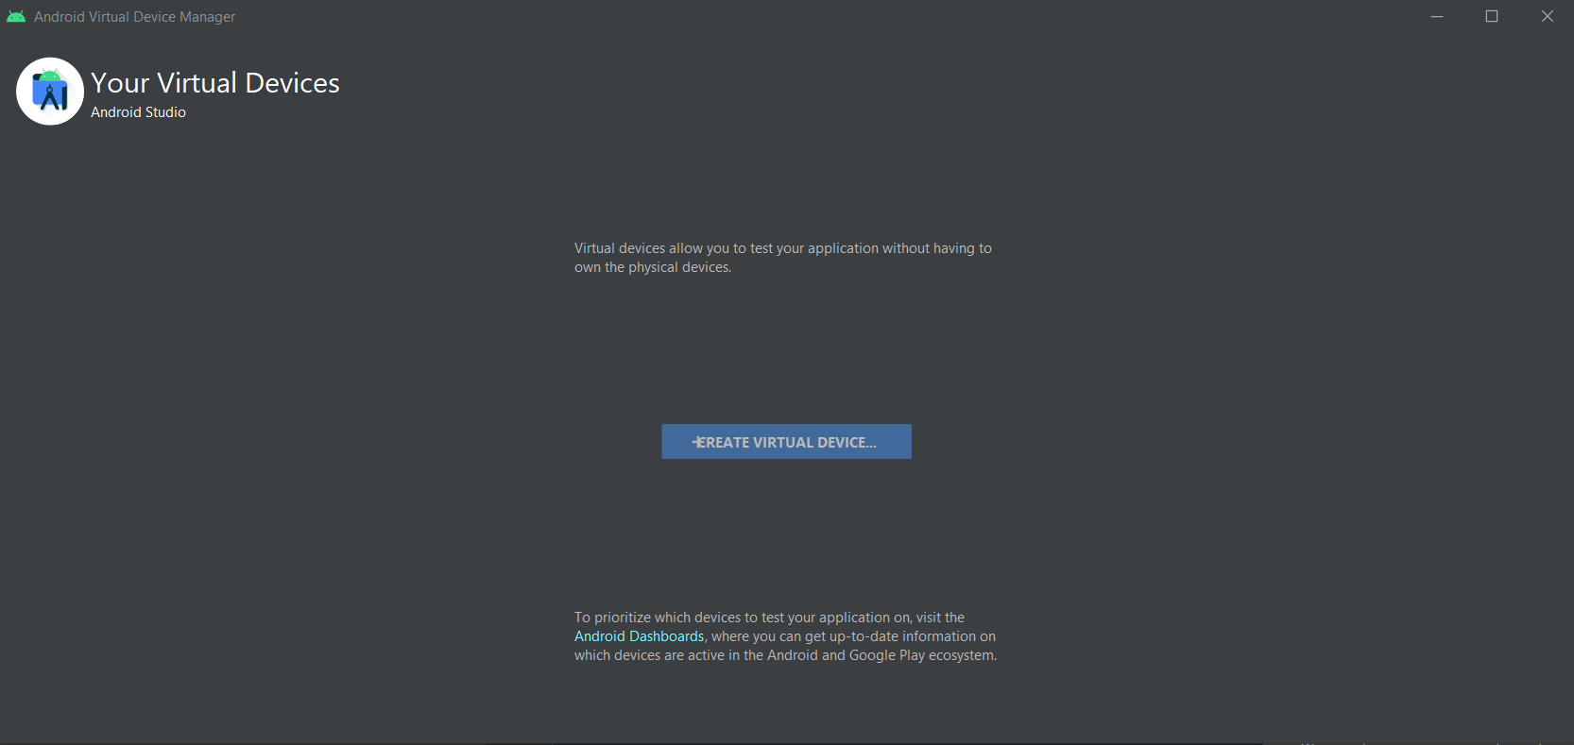
AVD Initialization (1)
In this page you create new AVD and manage AVD already existing

Slide 10
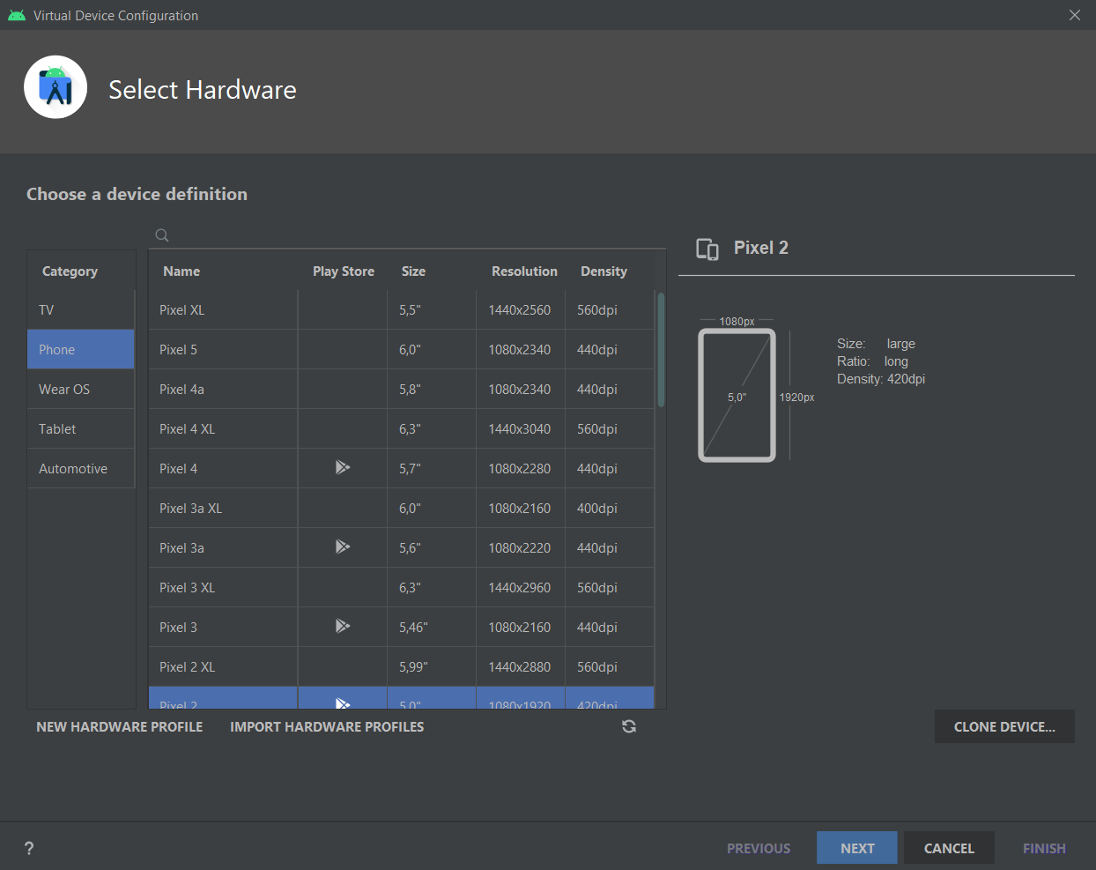
AVD Initialization (2)
You can choose
Type of AVD (Wear, Smarthphone, Tablet, Tv and Automotive)
Specific AVD (e.g. from Google devices list) (is better choose Play Store integrated AVD)

Slide 11
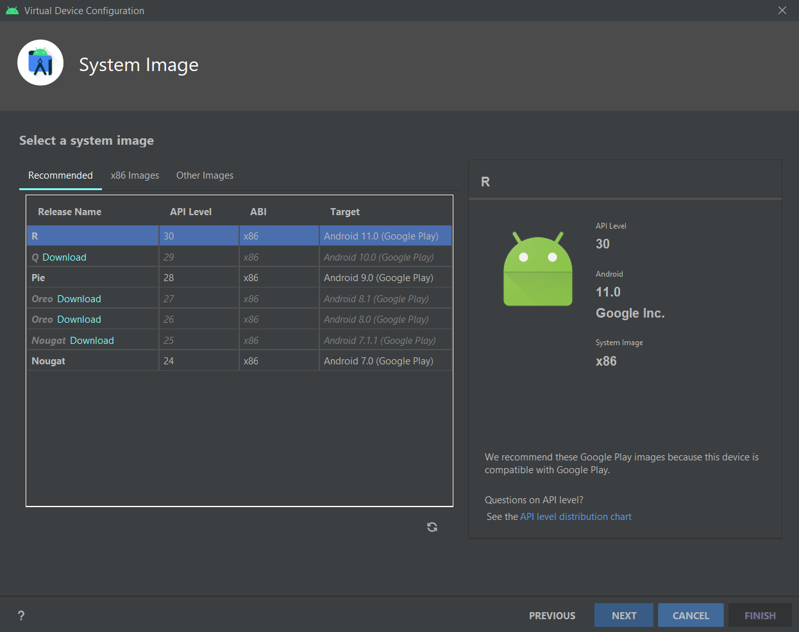
AVD Initialization (3)
API Level (with related Android OS version)

Slide 12
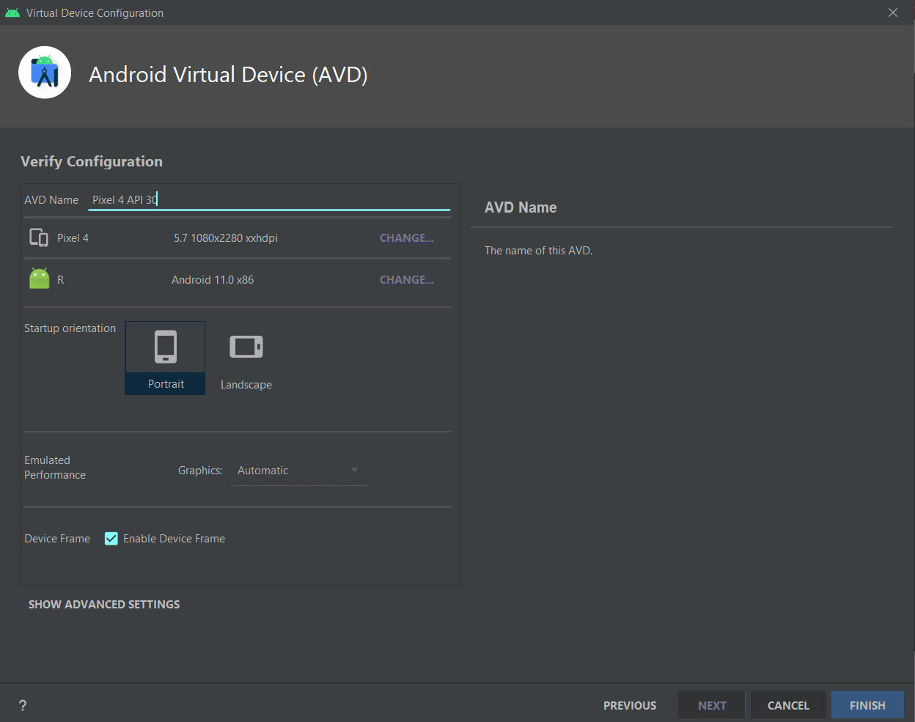
AVD Initialization (4)
Name of AVD
Other technical specifications (display resolution…)

Slide 13
Run and Debug
Run an application means:
Compiles source code to bytecode
Coverts bytecode to Android executable (.dex)
Packages the executable and project’s resources and manifest in Android package (.apk)
Deploys your APK in target device and installs it
Starts application

Slide 14
Run/Debug in real device
Android Studio offers the possibility to install your application and run it in a real Android device
Activate ADB (Android Debug Bridge) on target device (only on Android 6.0 or higher)
Settings ➔ About Phone/Tablet ➔ Software Information
Tap on Build number field seven times (a message appears indicating that developer mode has been enabled)
Go to Settings page and now appears Developer options
Switch on USB debugging option
Connect to PC with USB, device will appear in Android Studio devices list

Slide 15
Other components
Android Profiler: show the behavior and performance of your app in real time (CPU, memory managment, network traffic)
SQLite3: From a remote shell to your device or from your host machine, you can use the sqlite3 command-line program to manage SQLite databases created by Android applications. https://developer.android.com/studio/command-line/sqlite3
Logcat: show androd logging system (helps you to see what app is doing)

Slide 16
Import from VCS
Android Studio has GitHub plugin
Clone repository on your PC
Open code project directory from Android Studio
GitHub tools appear in Android Studio

Slide 17
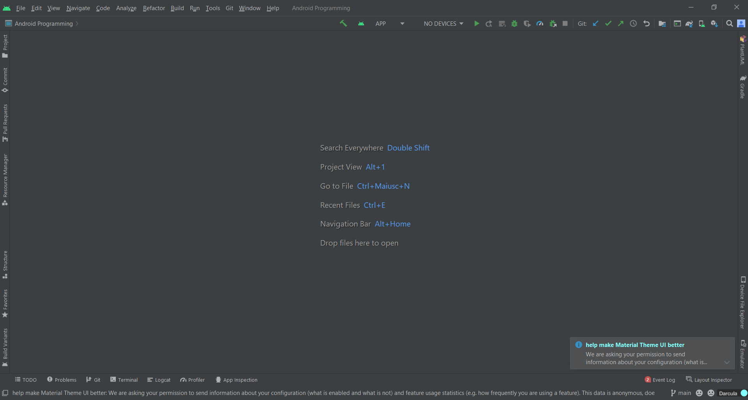
GitHub tools

Slide 18
Device file explorer
You can also explore storage device
If you use AVD, storage is a direactory in your PC
If you use Real device is the real file system
To see your app directory in storage
File explorer -> Data -> Data -> your app package (e.g. com.example.MyApplication)

Slide 19
Layout design tool
Android Studio offers 3 mode to manipulate graphic element (Layout, Drawable, ecc.), you can choose when you open an xml file
Code mode: use only xml
Split mode: use xml and graphic tool
Design mode: use only drag and drop graphic tool

Slide 20
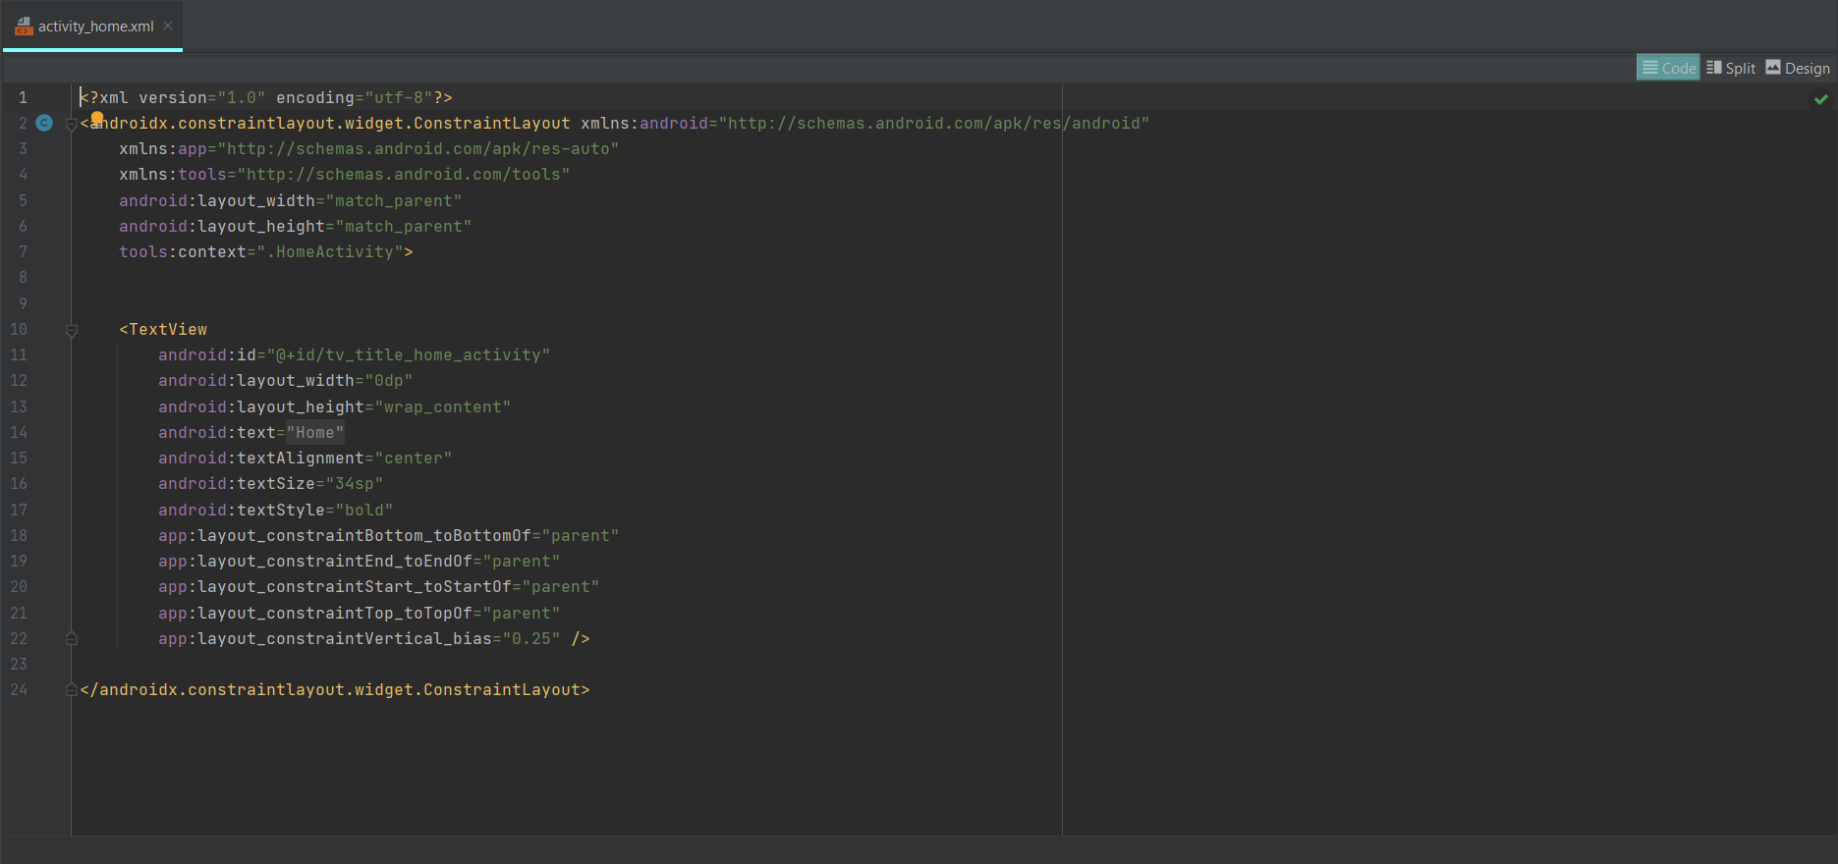
Code Mode

Slide 21
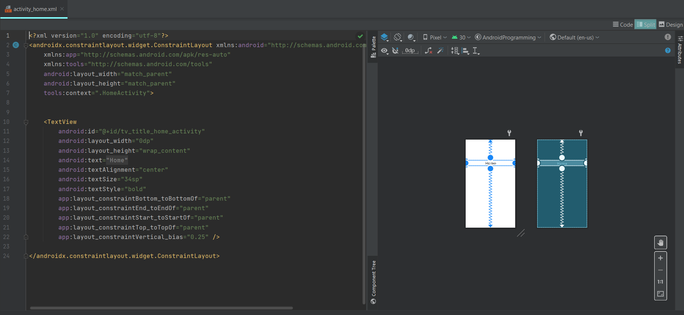
Split Mode

Slide 22
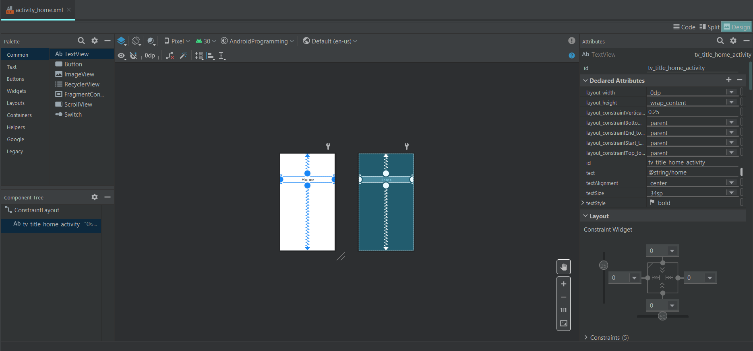
Design Mode

Slide 23
Opening sample project
File ➔ new ➔ import sample
Android studio offers the opportunity to import sample project
All sample code in Android Studio are available at https://github.com/googlesamples/

Slide 24
What is Gradle?
Gradle is an open-source and general-purpose build automation tool that is designed to be flexible enough to build almost any type of software.
Is based on Groovy or Kotlin scripts
Run on JVM (to use it you must install JDK)
Gradle manage your android project build, dependencies, versions, resources…
https://developer.android.com/studio/build

Slide 25
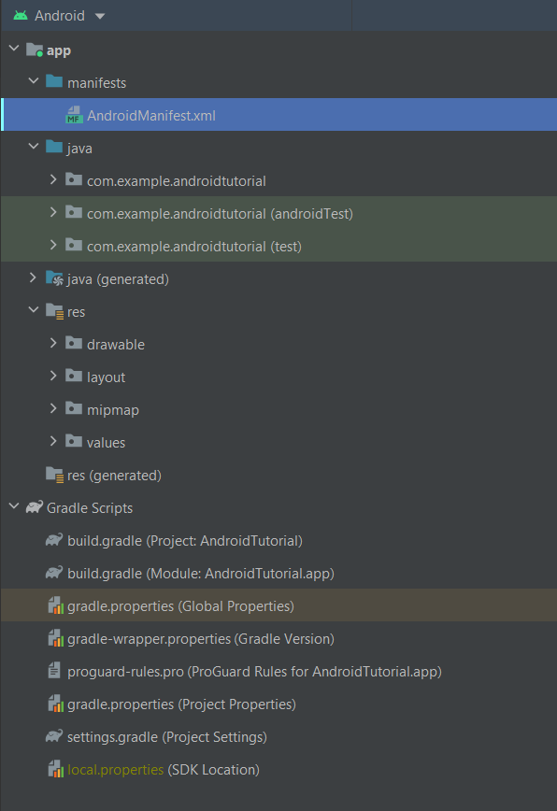
Project structure
When you create new project, Android Studio create a new application structure for you

Slide 26

AndroidManifest.xml
Package of your app
<?xml version="1.0" encoding="utf-8"?> <manifest xmlns:android="http://schemas.android.com/apk/res/android" package="com.example.androidtutorial"> <application android:allowBackup="true" android:fullBackupOnly="true" android:icon="@mipmap/ic_launcher" android:label="@string/app_name" android:roundIcon="@mipmap/ic_launcher_round" android:supportsRtl="true" android:theme="@style/Theme.AndroidTutorial"> <activity android:name=".IntroActivity" android:exported="true"> <intent-filter> <action android:name="android.intent.action.MAIN" /> <category android:name="android.intent.category.LAUNCHER" /> </intent-filter> </activity> </application> </manifest>
App icon
App
information
App’s theme
Activity info
(e.g. Launcher is the first ‘page’ of your app)

Slide 27
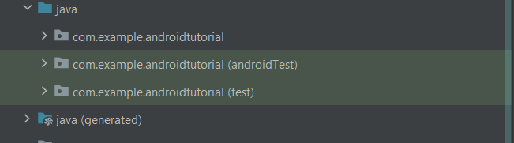
Java code folder
Contains ‘’real’’ java code (package, class, interface …)
Contains java code test

Slide 28
Res folder
Contains resources (image, string, layout, ecc…) that you could use in your app
Contains image (.png, .jpg) and more useful things
Contains layouts of your app
Contains your app logo
Contains string, colors and themes

Slide 29
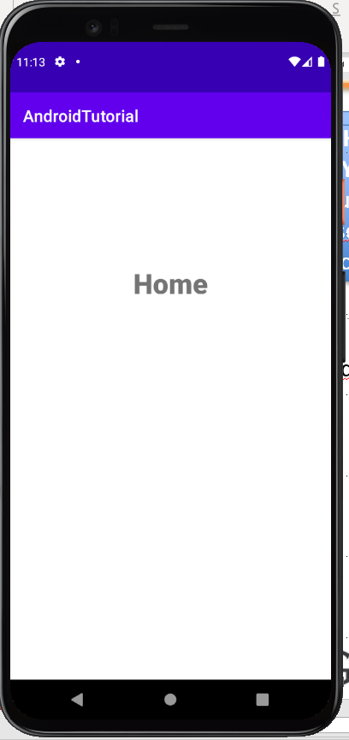
Layout folder
WHAT IS LAYOUT?
Layout is what user see on the screen
Layout type
An example:
<?xml version="1.0" encoding="utf-8"?> <androidx.constraintlayout.widget.ConstraintLayout xmlns:android="http://schemas.android.com/apk/res/android" xmlns:app="http://schemas.android.com/apk/res-auto" xmlns:tools="http://schemas.android.com/tools" android:layout_width="match_parent" android:layout_height="match_parent" tools:context=".HomeActivity"> <TextView android:id="@+id/tv_title_home_activity" android:layout_width="0dp" android:layout_height="wrap_content" android:text="Home" android:textAlignment="center" android:textSize="34sp" android:textStyle="bold" app:layout_constraintBottom_toBottomOf="parent" app:layout_constraintEnd_toEndOf="parent" app:layout_constraintStart_toStartOf="parent" app:layout_constraintTop_toTopOf="parent" app:layout_constraintVertical_bias="0.25" /> </androidx.constraintlayout.widget.ConstraintLayout>
Layout dimension
Activity binded to this layout (what activity show to user this layout)
Graphic element id
Graphic element dimension
Graphic element
Element properties
Where graphic element is placed on the screen

Slide 30
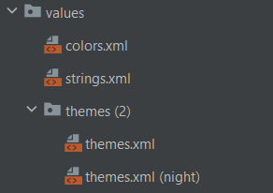
Values folder
<?xml version="1.0" encoding="utf-8"?> <resources> <color name="purple_200">#FFBB86FC</color> <color name="purple_500">#FF6200EE</color> <color name="purple_700">#FF3700B3</color> <color name="teal_200">#FF03DAC5</color> <color name="teal_700">#FF018786</color> <color name="black">#FF000000</color> <color name="white">#FFFFFFFF</color> </resources>
<resources> <string name="app_name">AndroidTutorial</string> <string-array name="week_day"> <item>Monday</item> <item>Tuesday</item> <item>Wednesday</item> <item>Thursday</item> <item>Friday</item> <item>Saturday</item> <item>Sunday</item> </string-array> </resources>
<resources xmlns:tools="http://schemas.android.com/tools"> <!-- Base application theme. --> <style name="Theme.AndroidTutorial" parent="Theme.MaterialComponents.DayNight.DarkActionBar"> <!-- Primary brand color. --> <item name="colorPrimary">@color/purple_500</item> <item name="colorPrimaryVariant">@color/purple_700</item> <item name="colorOnPrimary">@color/white</item> <!-- Secondary brand color. --> <item name="colorSecondary">@color/teal_200</item> <item name="colorSecondaryVariant">@color/teal_700</item> <item name="colorOnSecondary">@color/black</item> <!-- Status bar color. --> <item name="android:statusBarColor" tools:targetApi="l">?attr/colorPrimaryVariant</item> <!-- Customize your theme here. --> </style> </resources>

Slide 31
How to access resources?
In XML files:
@element_type/element_id
e.g.: android:text=‘’@string/app_name’’
In java files:
R.id.element_id
e.g.: textView.setText(R.id.app_name);

Slide 32
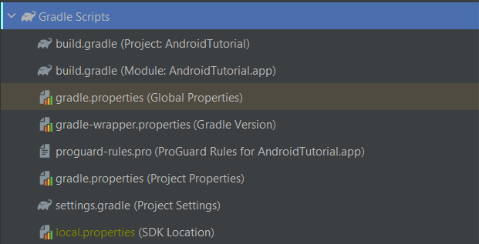
Gradle Scripts
Contains app properties

Slide 33
Build.gradle (Module: ProjectName.app)
plugins { id 'com.android.application' } android { compileSdk 30 defaultConfig { applicationId "com.example.androidtutorial" minSdk 21 targetSdk 30 versionCode 1 versionName "1.0" testInstrumentationRunner "androidx.test.runner.AndroidJUnitRunner" } buildTypes { release { minifyEnabled false proguardFiles getDefaultProguardFile('proguard-android-optimize.txt'), 'proguard-rules.pro' } } compileOptions { sourceCompatibility JavaVersion.VERSION_1_8 targetCompatibility JavaVersion.VERSION_1_8 } } dependencies { implementation 'androidx.appcompat:appcompat:1.3.1' implementation 'com.google.android.material:material:1.4.0' implementation 'androidx.constraintlayout:constraintlayout:2.1.1' testImplementation 'junit:junit:4.+' androidTestImplementation 'androidx.test.ext:junit:1.1.3' androidTestImplementation 'androidx.test.espresso:espresso-core:3.4.0' }
Your app id
Your app properties
Your app dependencies (third part module)

Slide 34
App properties
android { compileSdk 30 defaultConfig { applicationId "com.example.androidtutorial" minSdk 21 --> minimum SDK version that target device must support targetSdk 30 --> target SDK version versionCode 1 --> code version versionName "1.0" --> version name testInstrumentationRunner "androidx.test.runner.AndroidJUnitRunner" }

